Slide 1



Welcome to
REST API testing and automation using
Python programming +
Behave (module) +
BDD

Slide 2
Agenda
REST API testing in general (Why/ How etc)
REST API URL format (in general)
HTTP request/ response parameters
“User management” - REST API based web application for our demo and it’s specifications
Testing aspects for this web application
BDD what/ how
Testing using Python programming language

Slide 3
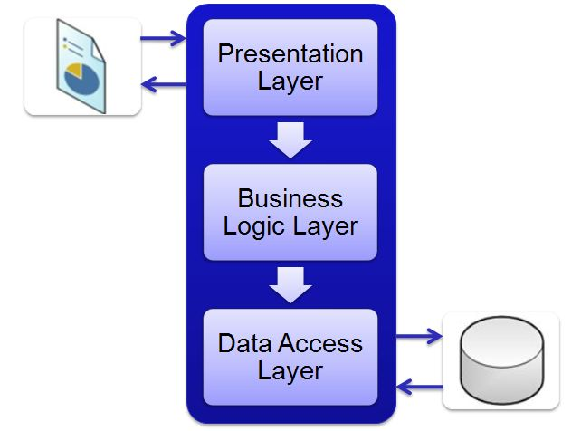
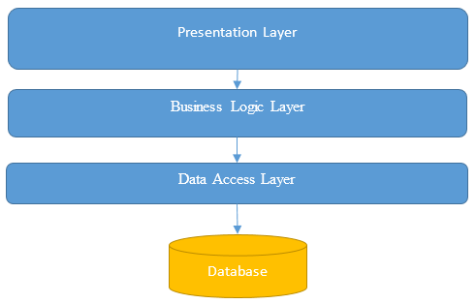
REST API testing in general (Why/ How)
GUI testing
API testing
API testing to verify functionality on cross platform support and multi language support.
GUI tests can't sufficiently verify functional paths and back-end APIs/services associated with multitier architectures.
To determine whether APIs return the correct response (in the expected format).

Slide 4
REST API URL format (in general)
<protocol>://<uri:port>/<version>/<serviceendpoint>/<parameters>
e.g.
https://github.com:8080/v3/users?id=mademethink

Slide 5
HTTP request parameters
Typical five major parts:
Verb - Indicate HTTP methods such as GET, POST, DELETE, PUT etc.
URI - Uniform Resource Identifier (URI) to identify the resource on server.
HTTP Version - Indicate HTTP version, for example HTTP v1.1.
Request Header - Contains metadata for the HTTP Request message as key
-value pairs. For example, client ( or browser) type, format supported by client,
format of message body, cache settings etc.
Request Body - Message content or Resource representation.
HTTP Request
Param Type:
Query,
Form,
Path,
Matrix,
Bean
Verb
URI
Version
Header
Body
User
Agent
Content
type
Accept
type
Connection
Timeout
Cache
Setting

Slide 6
HTTP response parameters
Typical four major parts -
Status/Response Code - Indicate Server status for the requested resource.
Standard codes and refers to predefined status of task done at server.
HTTP Version - Indicate HTTP version, for example HTTP v1.1.
Response Header - Contains metadata for the HTTP Response message as key
-value pairs. For example, content length, content type, response date, server
type etc.
Response Body - Response message content or Resource representation.
HTTP Response
Status code
Version
Header
Body
Text,
Image,
Link
Content
type
Content
length
Response
date
Cache
setting

Slide 7

User Management – demo web application
Signup
Signin
Signout
Activate
Get Session Key
Get Account
Profile Details
Get
Activation
Key
Modify Account
Profile Details
Activation
Key
Regenerate
User
Management
Forget
Password
Delete
Get Documentation
Reset
Password
List of implemented REST API
Specification Document

Slide 8
Demo application setup/ installation
Download web application (.war) file from Github.
Install tomcat locally to host the application.
Choose port # or let it be default (8080).
Copy .war file in appropriate folder and run/ restart tomcat.
Invoke get documentation API to check if web app is working as expected.

Slide 9
Testing aspects:
To test APIs (valid input valid output, invalid input invalid output)
To test few typical sequence of user actions.
Sequence-1
Get Signup parameters
Signup
Activate basic account
Sign in
Sign out
Sequence-2
Get Signup parameters
Signup
Activate account
Sign in
Get account profile
Modify Profile
Sign out
Sequence-3
Get Signup parameters
Signup
Activate account
Sign in
Forget password
Reset password
Sign out
Sign in
Sequence-5
Get Signup parameters
Signup
Activate basic account
Sign in
Get account profile
Sign out
Sequence-6
Signup
Sign out
Forget password
Get account profile
Sequence-4
Get Signup parameters
Signup
Sign in

Slide 10
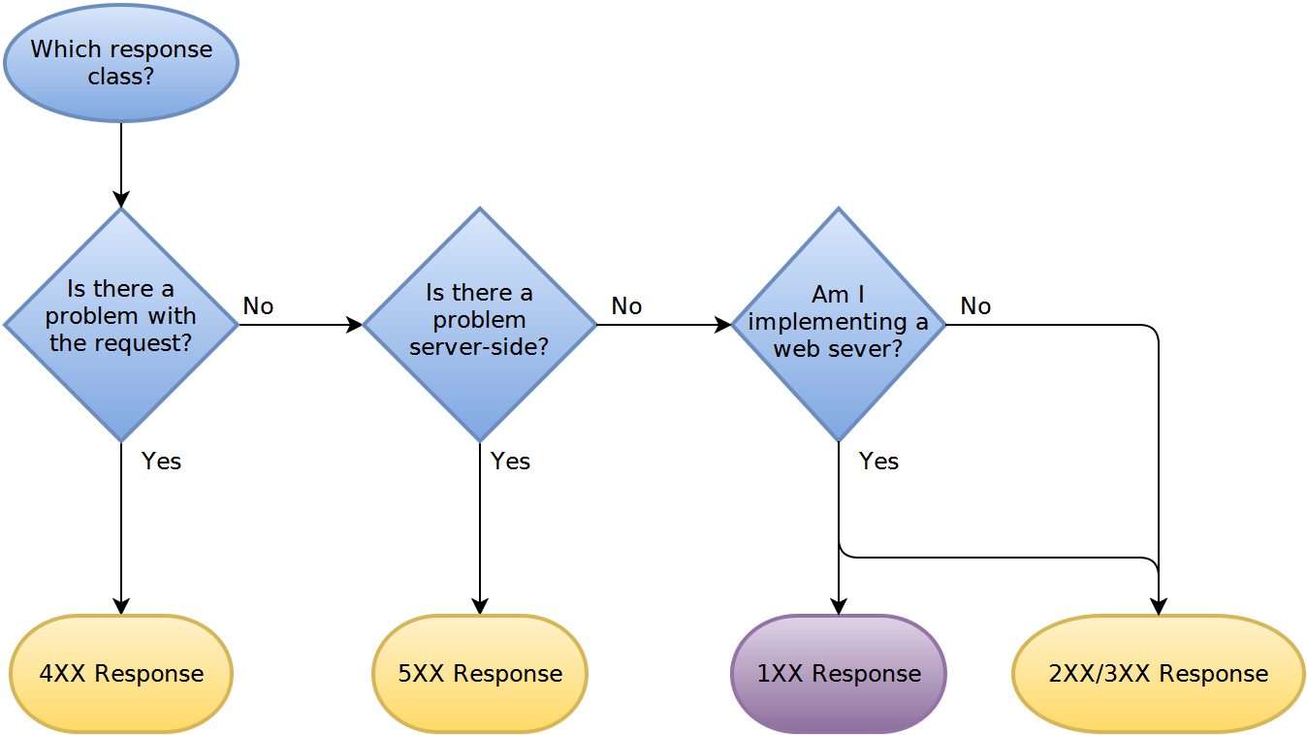
HTTP response handling sequence

Slide 11

BDD (Behaviour Driven Development)
1) Test case design using Behave for easy
and quick understanding.

Slide 12
REST API testing using Python programming
requests module (version used is 2.15.1)
https://pypi.python.org/pypi/requests
urllib3 module
https://pypi.python.org/pypi/urllib3

Slide 13
REST API testing using Python programming
REQUESTS module
https://pypi.python.org/pypi/requests
Pip install requests
GET request example
PUT request example
DELETE request example
POST request example
Header settings
Raising HTTP request
Parameter passing (Query param, Form param etc)
Response handling

Slide 14

Welcome to
REST API Testing Automation Framework

Slide 15
Framework building blocks
Header making
Content-type,
Accept-type,
Cache etc
Body making
Query param, Form param,
Bean param, Matrix param etc.
Cucumber BDD support
Server health check
Raise HTTP Request
(GET, PUT, POST, DELETE etc)
Server log analysis
JSON handling
Framework
Test data input using
XLS,
CSV (Apache POI)
Properties file
Parse HTTP Response
(Status code,
Response Header)
Test result reporting
Html format
JIRA, HP ALM etc
Parse HTTP Response
(Response Body)

